Slide 1

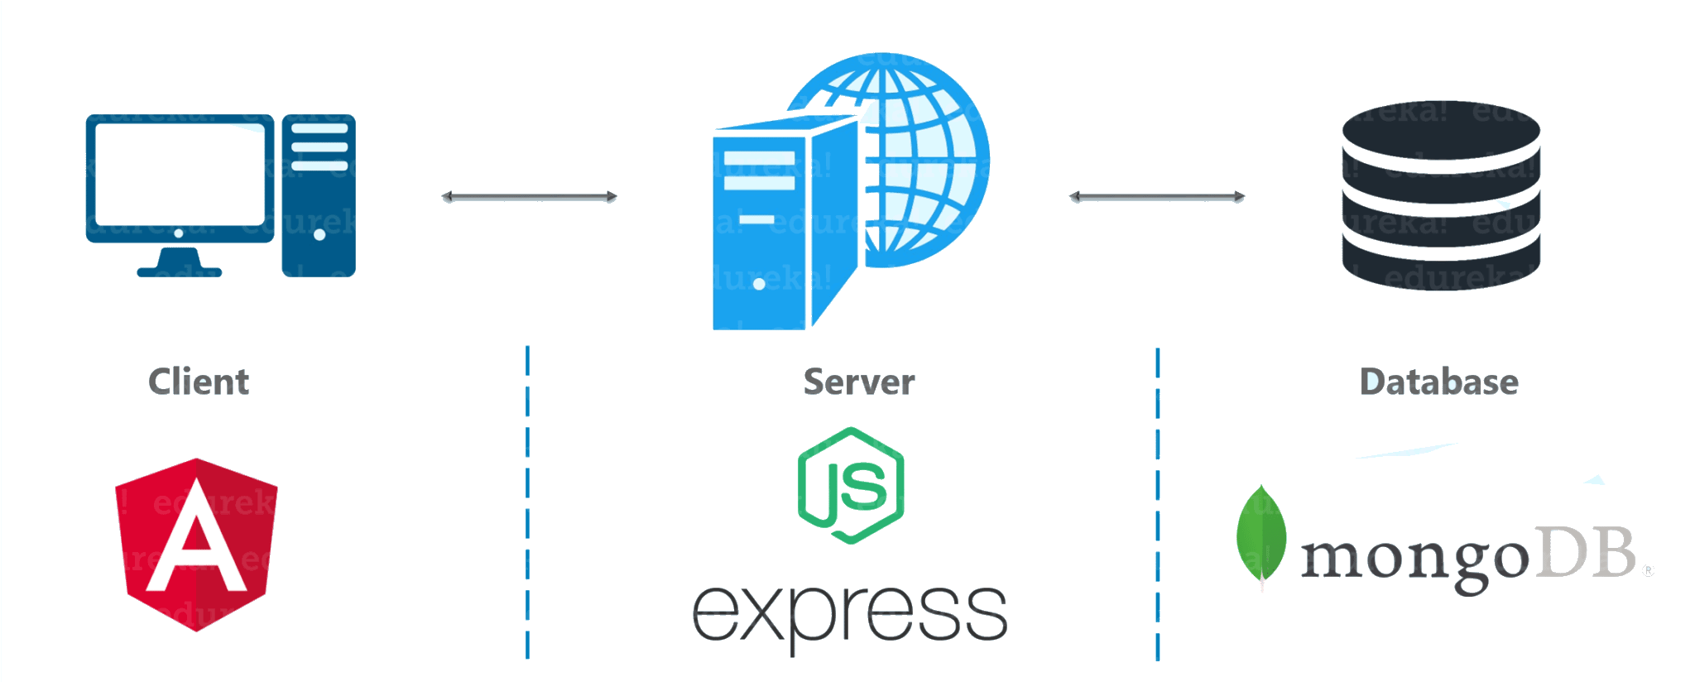
Open Source
Solutions for SMEs
Software Development
Focus: Deployment to Host Online
Heroku MongoDB Atlas

Slide 2

Open Source
Solutions for SMEs
Software Development
… and yet again!
LeROIFOPESON
Information Systems & Technology Consultant
Linux Professional Institute (LPI-2) Certified
Used MS/PC DOS, Windows 3, 95, 98, XP & 7
(XP was my favorite)
Switched to Linux
Abimbola Adefope
Speaker

Slide 3
Open Source
Solutions for SMEs
Open Source Software Development
Software Development
Assignment Review:
Download and install the Bitnami MEAN Stack on your local computer.
Install all the Angular & ExpressJS components.
Go to https://github.com/opensmes to download or clone copies of the frontend and backend source code.
Use these to reproduce the open source application on your local computer

Slide 4
Open Source
Solutions for SMEs
Software Development
Project Deployment
Project Preparation
The development mode is while the software project is being developed and tested on a local or staging server.
When the project is ready for final deployment online, it must be prepared to run in the production mode.
This requires further code optimization and configuration with parameters that enable it to run successfully on an online hosting service (e.g. Heroku, Azure) and with any other additional service providers that will be required (e.g. MongoDB Atlas)
Git and Github will still be required to stage the production project code in an online repository before deployment.

Slide 5
Open Source
Solutions for SMEs
Software Development
Project Deployment
MEAN Stack Project: Online Hosting Services
Heroku
Sign up for free account at Heroku website.
Create new app,
Use Github for deployment
Connect to Github and select repository for deployment.
Use URL of app on Heroku, to configure Angular frontend before production build
MongoDB Atlas
Sign up for free account at MongoDB website with a Google account.
Select the Free service after supplying all required information.
Create database, user and password in Cluster0
Get connection URI to configure Node backend for production.
Github
Push production deployment code to a Github repository.

Slide 6
Open Source
Solutions for SMEs
Software Development
Project Deployment
MEAN Stack Project Preparation for Production
Frontend: Angular
Configure environment.prod file with the URL of the backend server hosted online.
In the bash shell of the folder containing the frontend source code, run
ng build –prod
This creates static HTML and script files in a new folder called dist which can be hosted separately online.
Backend: NodeJS & Express
Configure database connection URI with the URI of the MongoDB Atlas server hosted online.
Optimize source code to remove all development stage dependencies (e.g. debugging and terminal logging).
Backend requires a NodeJS hosting service provider.

Slide 7
Open Source
Solutions for SMEs
Software Development
Project Deployment
MEAN Stack Project Preparation for Production
Types of Deployment
Separated Hosting - Frontend code is hosted on a different hosting service from the backend, or at least at another IP address.
Preferred if the backend provides multiple services to other frontend apps
Integrated Hosting - Frontend and Backend code are combined and hosted by one hosting service.
Used when there is only one frontend app for the backend
We will be using the integrated option for our project and hosting it on Heroku.

Slide 8

Open Source
Solutions for SMEs
Open Source Software Development
Software Development
From the fourth session
DEMO: The MEAN Stack
C. Source Code Version Control & Collaboration – Git
4. .gitignore should include, among others:
node_modules/
5. Run the following to ensure that only the desired files are being tracked:
echo “ Code name & other information” >> README.md
git status - node_modules directory and any other files listed in .gitignore should not be listed
git add . - To add files listed to the local Git repository
git status - Shows files to be committed
git commit – m “Insert name of commit” - To prepare code for staging in a remote repository.
6. Step 5. may be repeated as many times as there are notable changes made to the contents of the files being tracked.

Slide 9

Open Source
Solutions for SMEs
Open Source Software Development
Software Development
From the fourth session
DEMO: The MEAN Stack
C. Source Code Version Control & Collaboration – Git & Github
To make the software available to collaborators and other remote users,
the commits have to be pushed to an repository online, like Github.
Create a Github account and a repository at github.com
At local command-line run the following commands:
git remote add origin https://github.com/username/repository-name.git
git branch –M main
git push –u origin main
10. Enter username and password for the Github account when prompted.

Slide 10
Open Source
Solutions for SMEs
Software Development
Project Deployment
MEAN Stack Project Deployment
Final steps
Browse to the Heroku server URL for the app, to see the hosted project online.
Subsequent updates pushed to the Github repository will be used to update the online project automatically, by the Heroku service.
DEMO:
How to create Heroku & MongoDB Atlas accounts .
How to create apps and databases on the respective services.

Slide 11
Open Source
Solutions for SMEs
Open Source Software Development
Software Development
Assignment:
Create Heroku & MongoDB Atlas accounts .
Create app and database on the respective services.
Fork or connect to the Github repository of our production code and host the project through your new Heroku app. It will connect to the database we have already created on Atlas MongoDB .
Alternatively, modify the db connection code in db.js file in the _startup folder of the project code to connect to your own Atlas MongoDB database.

Slide 12

Open Source
Solutions for SMEs
Software Development
Next session:
Thank you for listening.

